Slide 1
Burghfield Neighbourhood Development Plan questionnaire

Slide 2
557
Total Responses
Complete Responses: 547

Slide 3
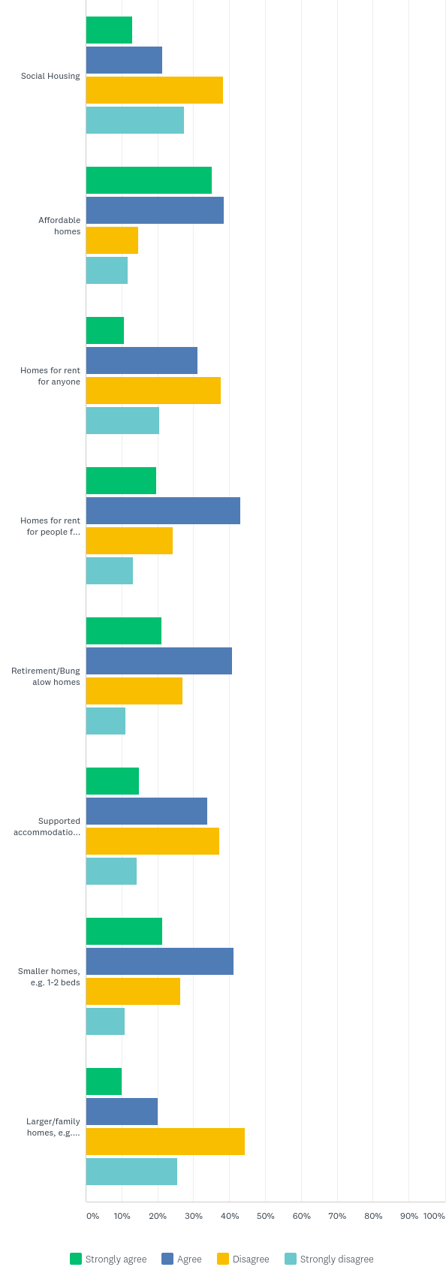
Q 1. West Berkshire Council’s Local Plan Review to 2036 will determine the number of new houses to be built in our parish, but the NDP will have considerable influence over location and character of any new development. Burghfield will need to provide a prescribed increased number of dwellings. Do you feel there is a shortage of certain types of housing? (mark one or more):
Answered: 526 Skipped: 31

Slide 4
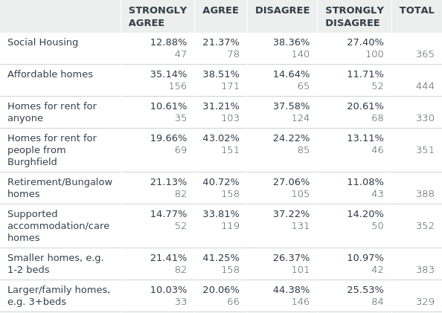
Q 1. West Berkshire Council’s Local Plan Review to 2036 will determine the number of new houses to be built in our parish, but the NDP will have considerable influence over location and character of any new development. Burghfield will need to provide a prescribed increased number of dwellings. Do you feel there is a shortage of certain types of housing? (mark one or more):
Answered: 526 Skipped: 31

Slide 5
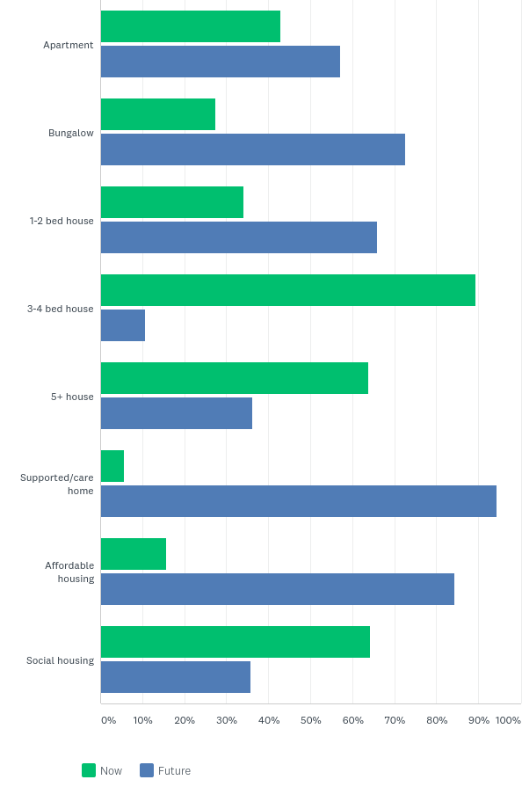
Q 2. What type of property do you currently live in, and what would be most suitable for your household member(s) in the future? (mark all that apply):
Answered: 542 Skipped: 15

Slide 6
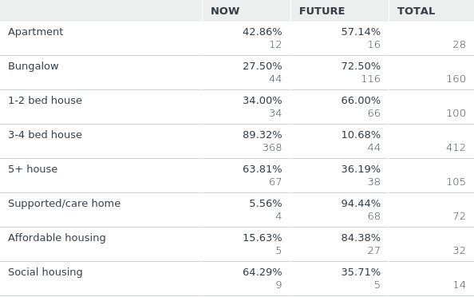
Q 2. What type of property do you currently live in, and what would be most suitable for your household member(s) in the future? (mark all that apply):
Answered: 542 Skipped: 15

Slide 7
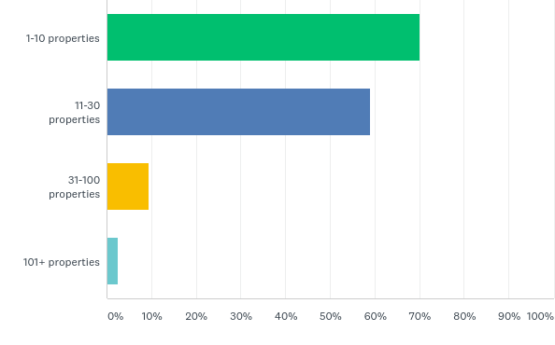
Q 3. Neighbourhood Plans may include multiple allocations of land for housing. What size of sites would you like to see allocated? (mark up to 3 boxes):
Answered: 529 Skipped: 28

Slide 8
Q 3. Neighbourhood Plans may include multiple allocations of land for housing. What size of sites would you like to see allocated? (mark up to 3 boxes):
Answered: 529 Skipped: 28

Slide 9
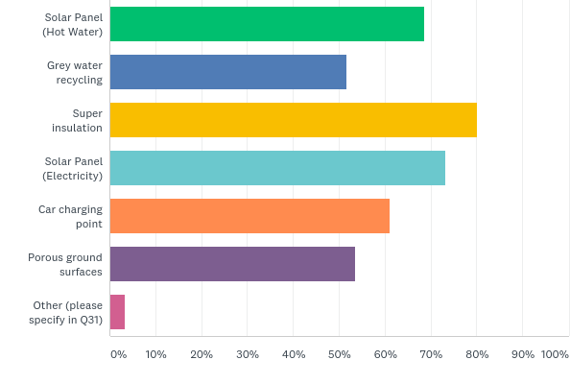
Q 4. What green technology should be required in new developments? (mark one or more):
Answered: 537 Skipped: 20

Slide 10
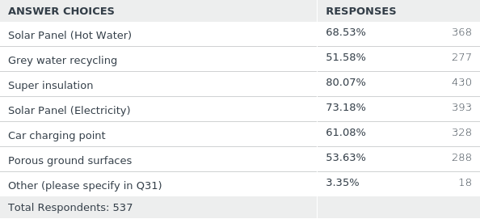
Q 4. What green technology should be required in new developments? (mark one or more):
Answered: 537 Skipped: 20

Slide 11
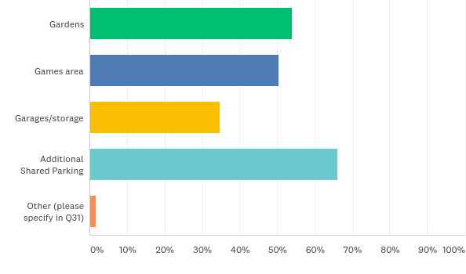
Q 5. Should new developments include the following shared facilities? (mark those you would like to see):
Answered: 494 Skipped: 63

Slide 12
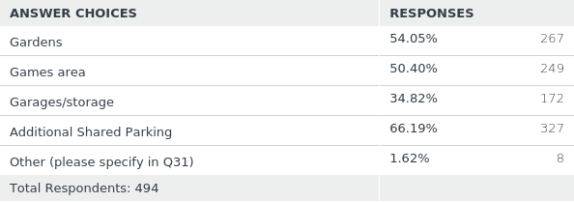
Q 5. Should new developments include the following shared facilities? (mark those you would like to see):
Answered: 494 Skipped: 63

Slide 13
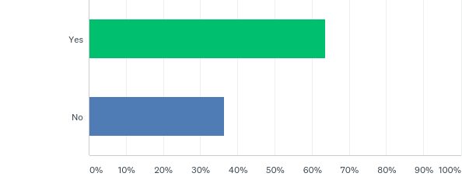
Q 6. Of the land which is allocated for building, should some be made available for individual self-builds?
Answered: 531 Skipped: 26

Slide 14
Q 6. Of the land which is allocated for building, should some be made available for individual self-builds?
Answered: 531 Skipped: 26

Slide 15
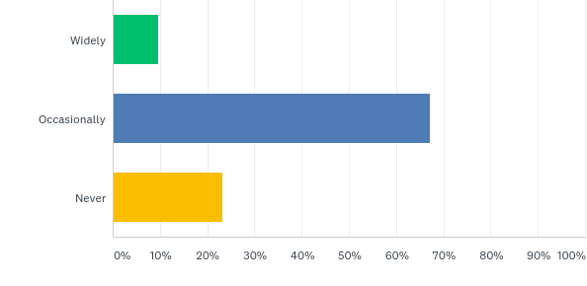
Q 7. Should infill (back garden) development be permitted?
Answered: 532 Skipped: 25

Slide 16
Q 7. Should infill (back garden) development be permitted?
Answered: 532 Skipped: 25

Slide 17
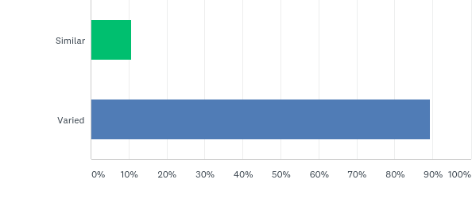
Q 8. Should dwellings in new housing developments all look similar, or be of varied design?
Answered: 539 Skipped: 18

Slide 18
Q 8. Should dwellings in new housing developments all look similar, or be of varied design?
Answered: 539 Skipped: 18

Slide 19
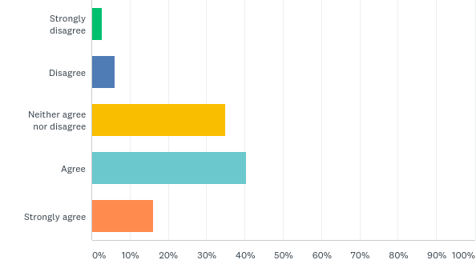
Q 9. Would you agree that more information boards and signs for our heritage assets are required? (mark one box):
Answered: 535 Skipped: 22

Slide 20
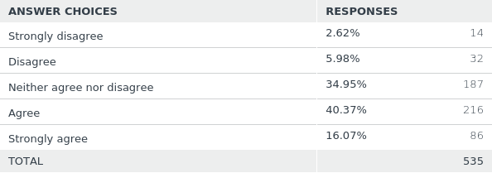
Q 9. Would you agree that more information boards and signs for our heritage assets are required? (mark one box):
Answered: 535 Skipped: 22

Slide 21
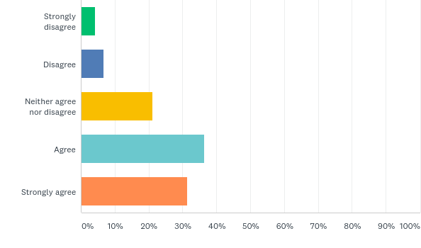
Q 10. Should a special effort be made to preserve the World War II defence sites on the Kennet & Avon canal? (mark one box)
Answered: 538 Skipped: 19

Slide 22
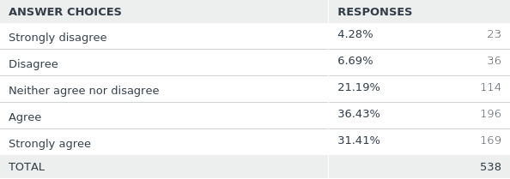
Q 10. Should a special effort be made to preserve the World War II defence sites on the Kennet & Avon canal? (mark one box)
Answered: 538 Skipped: 19

Slide 23
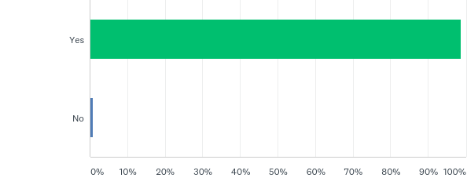
Q 12. In planning terms Green Spaces eg. allotments, recreation grounds or parks are within, or close to the community they serve. Is it important to retain existing green spaces in the parish?
Answered: 538 Skipped: 19

Slide 24
Q 12. In planning terms Green Spaces eg. allotments, recreation grounds or parks are within, or close to the community they serve. Is it important to retain existing green spaces in the parish?
Answered: 538 Skipped: 19

Slide 25
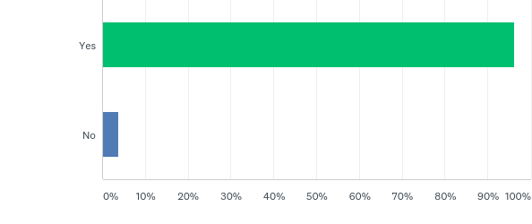
Q 13. Would you like to see green space in any new developments?:
Answered: 536 Skipped: 21

Slide 26
Q 13. Would you like to see green space in any new developments?:
Answered: 536 Skipped: 21

Slide 27
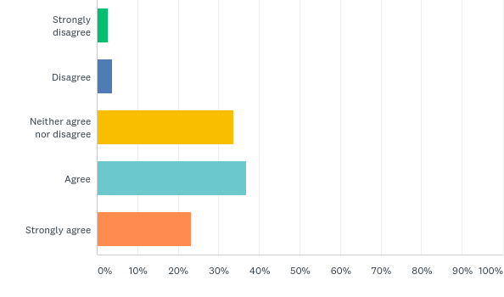
Q 14. Should all new properties should have front gardens? (mark one box)
Answered: 535 Skipped: 22

Slide 28
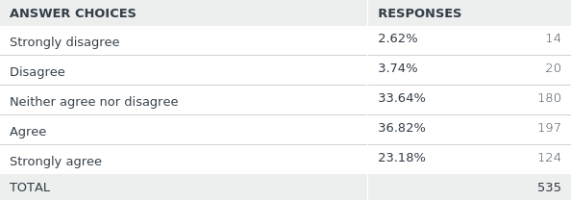
Q 14. Should all new properties should have front gardens? (mark one box)
Answered: 535 Skipped: 22

Slide 29
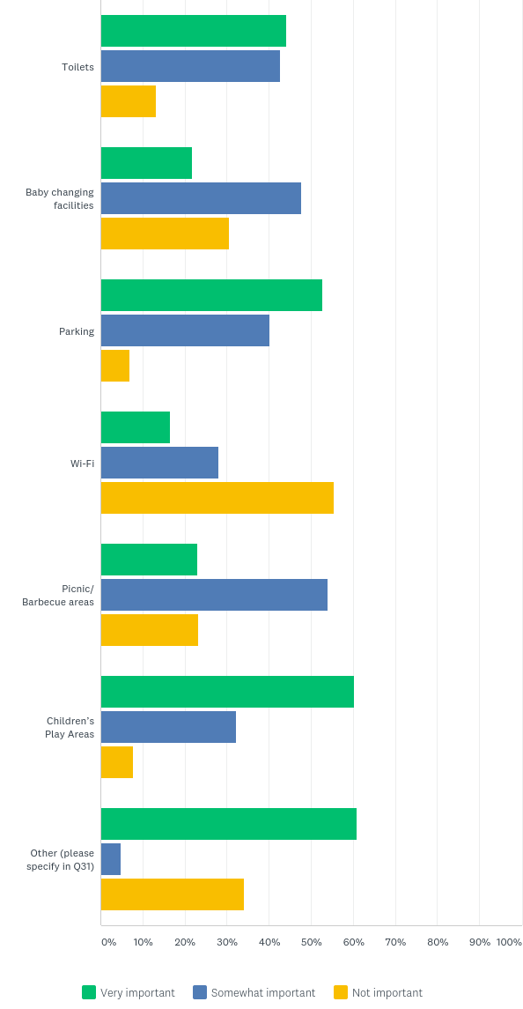
Q 15. How important are the following facilities to you in public spaces? (mark boxes):
Answered: 534 Skipped: 23

Slide 30
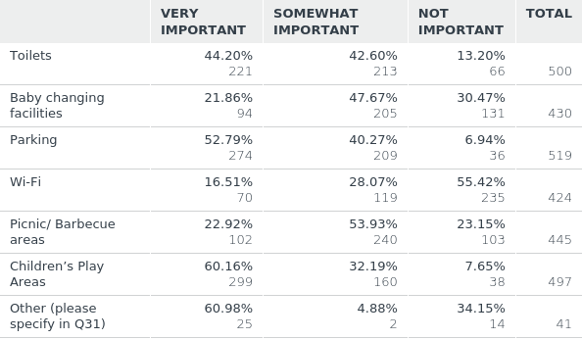
Q 15. How important are the following facilities to you in public spaces? (mark boxes):
Answered: 534 Skipped: 23

Slide 31
Q 16. Do you think that new public spaces should be lit at night? (mark one box):
Answered: 529 Skipped: 28

Slide 32
Q 16. Do you think that new public spaces should be lit at night? (mark one box):
Answered: 529 Skipped: 28

Slide 33
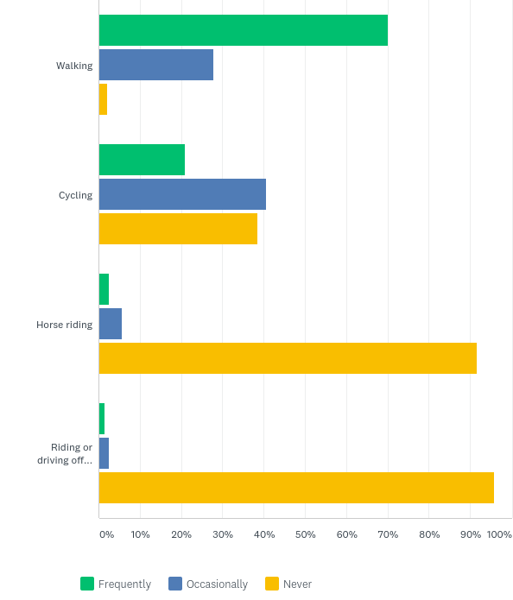
Q 17. Do you use the parish footpaths, bridle paths and byways? (mark boxes):
Answered: 539 Skipped: 18

Slide 34
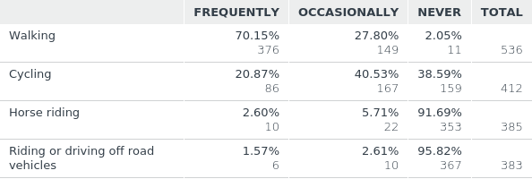
Q 17. Do you use the parish footpaths, bridle paths and byways? (mark boxes):
Answered: 539 Skipped: 18

Slide 35
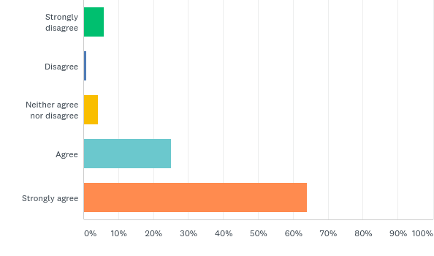
Q 20. We should protect the extensive area of lake and wetland habitats in the northern part of the Parish for the benefit of the diverse wildlife (mark one box):
Answered: 537 Skipped: 20

Slide 36
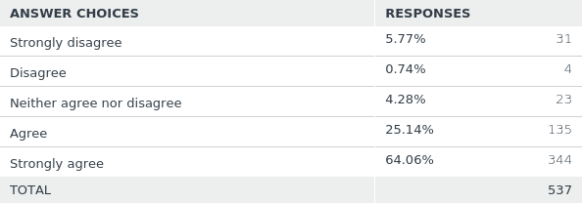
Q 20. We should protect the extensive area of lake and wetland habitats in the northern part of the Parish for the benefit of the diverse wildlife (mark one box):
Answered: 537 Skipped: 20

Slide 37
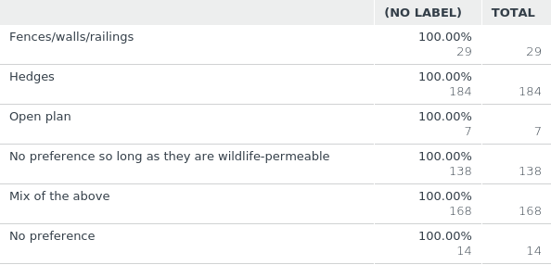
Q 21. Which type of property boundary marker would you prefer? (mark one box):
Answered: 540 Skipped: 17

Slide 38
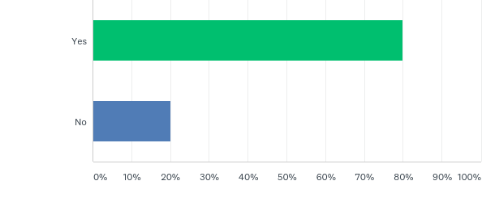
Q 22. In new developments would you like grass verges between the pavement and the road? (mark one box):
Answered: 536 Skipped: 21

Slide 39
Q 22. In new developments would you like grass verges between the pavement and the road? (mark one box):
Answered: 536 Skipped: 21

Slide 40
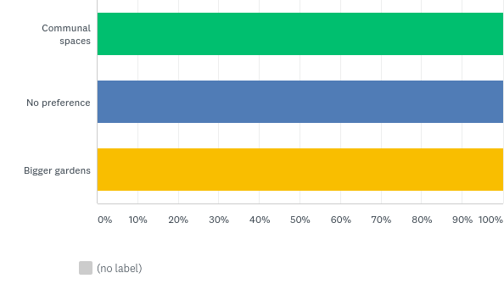
Q 23. Should new developments focus more on (mark one box):
Answered: 530 Skipped: 27

Slide 41
Q 23. Should new developments focus more on (mark one box):
Answered: 530 Skipped: 27

Slide 42
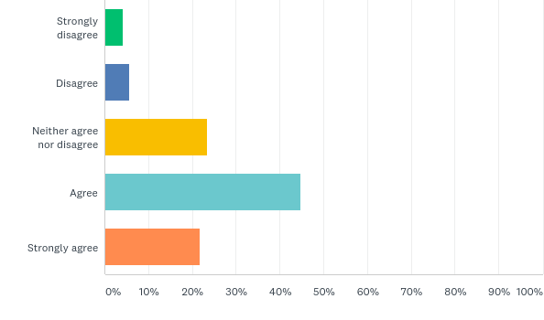
Q 24. New developments should have restrictions to control boundary (fence/wall) height (mark one box):
Answered: 540 Skipped: 17

Slide 43
Q 24. New developments should have restrictions to control boundary (fence/wall) height (mark one box):
Answered: 540 Skipped: 17

Slide 44
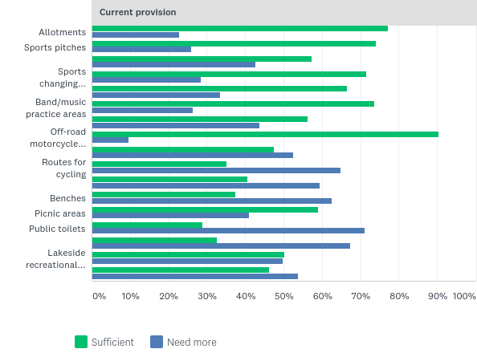
Q 25. What do you think of the current provision of these facilities and which are your priorities for future developments?If you have comments about location of these facilities, please add comments to the end of the questionnaire.
Answered: 538 Skipped: 19

Slide 45
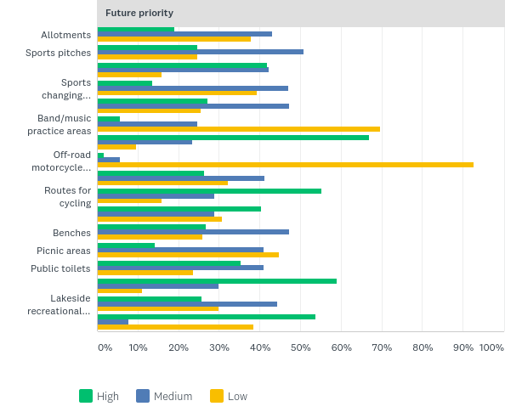
Q 25. What do you think of the current provision of these facilities and which are your priorities for future developments?If you have comments about location of these facilities, please add comments to the end of the questionnaire.
Answered: 538 Skipped: 19

Slide 46
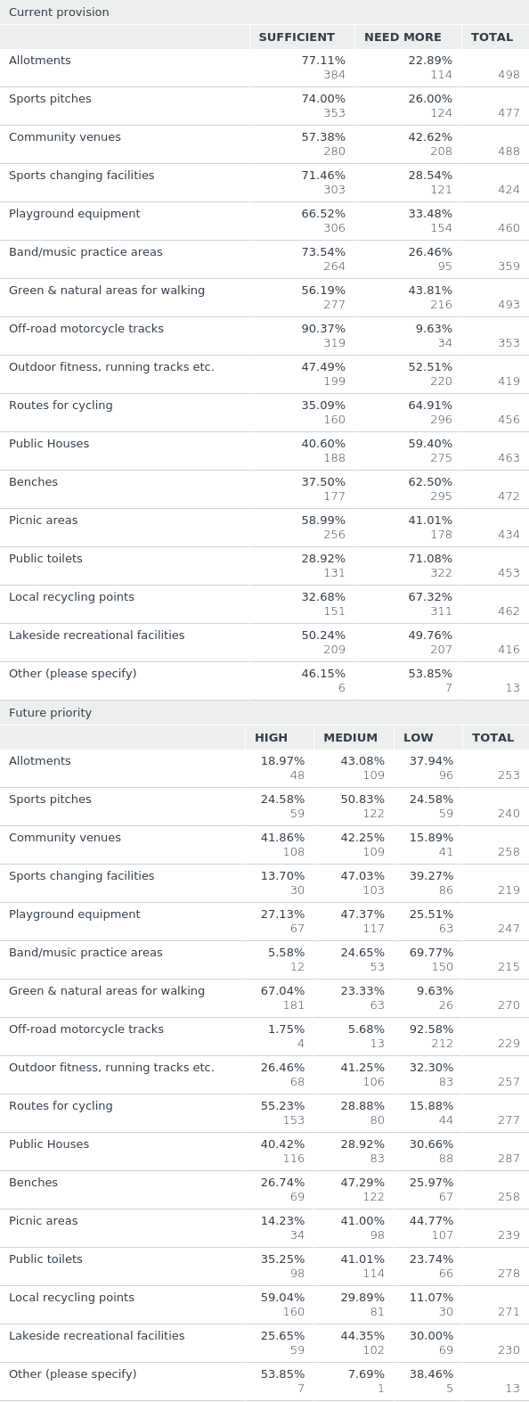
Q 25. What do you think of the current provision of these facilities and which are your priorities for future developments?If you have comments about location of these facilities, please add comments to the end of the questionnaire.
Answered: 538 Skipped: 19

Slide 47
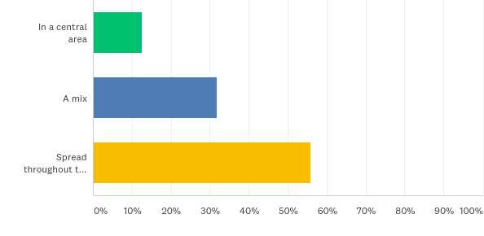
Q 26. Should the village have a shopping centre or should shops be spread throughout the Parish? (mark one box):
Answered: 529 Skipped: 28

Slide 48
Q 26. Should the village have a shopping centre or should shops be spread throughout the Parish? (mark one box):
Answered: 529 Skipped: 28

Slide 49
Q 27. Should there be a business centre, or should employment opportunities be spread throughout the Parish? (mark one box):
Answered: 530 Skipped: 27

Slide 50
Q 27. Should there be a business centre, or should employment opportunities be spread throughout the Parish? (mark one box):
Answered: 530 Skipped: 27

Slide 51
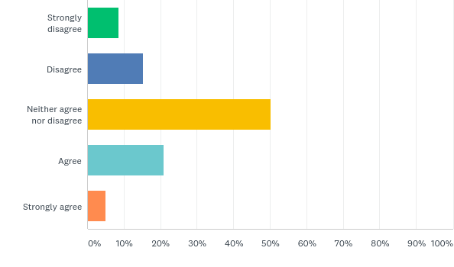
Q 28. Tourism within the parish should be promoted (mark one box):
Answered: 537 Skipped: 20

Slide 52
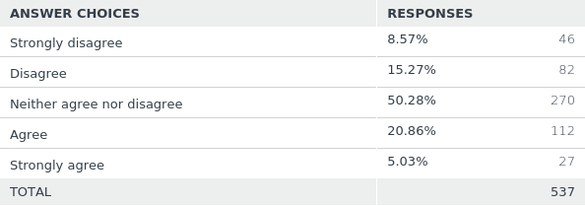
Q 28. Tourism within the parish should be promoted (mark one box):
Answered: 537 Skipped: 20

Slide 53
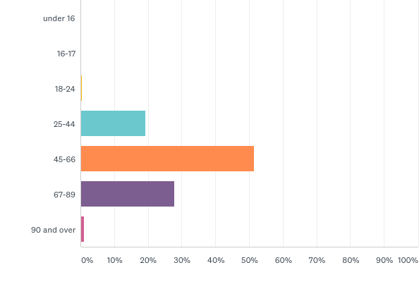
Q 29. How old are you:
Answered: 527 Skipped: 30

Slide 54
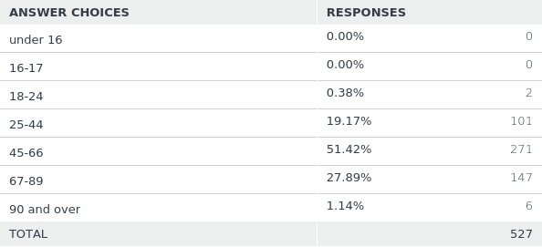
Q 29. How old are you:
Answered: 527 Skipped: 30

Slide 55
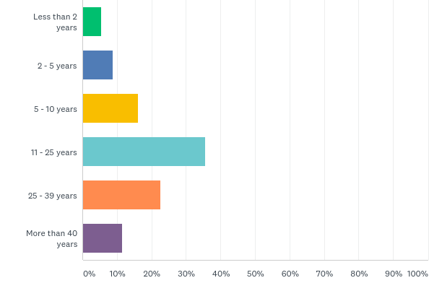
Q 30. How long have you lived in the parish of Burghfield?
Answered: 530 Skipped: 27

Slide 56
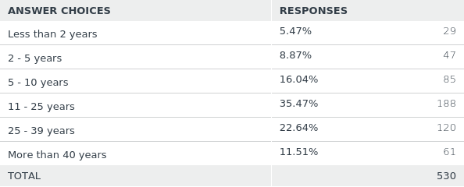
Q 30. How long have you lived in the parish of Burghfield?
Answered: 530 Skipped: 27

